Slide 1




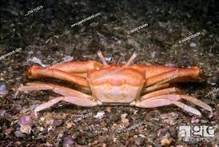
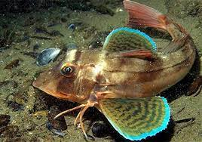
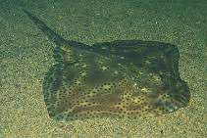
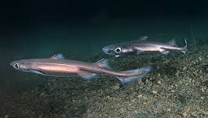
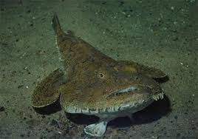
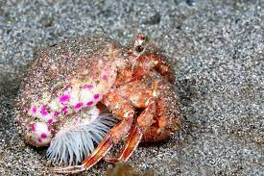
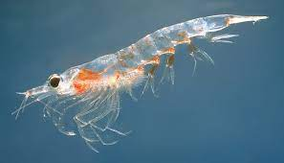
FW4
Changes in average trophic level of marine predators
<>< Trophic ecology team <><
CN Instituto Español de Oceanografía (IEO-CSIC)
*Contact: izaskun.preciado@ieo.es

Slide 2
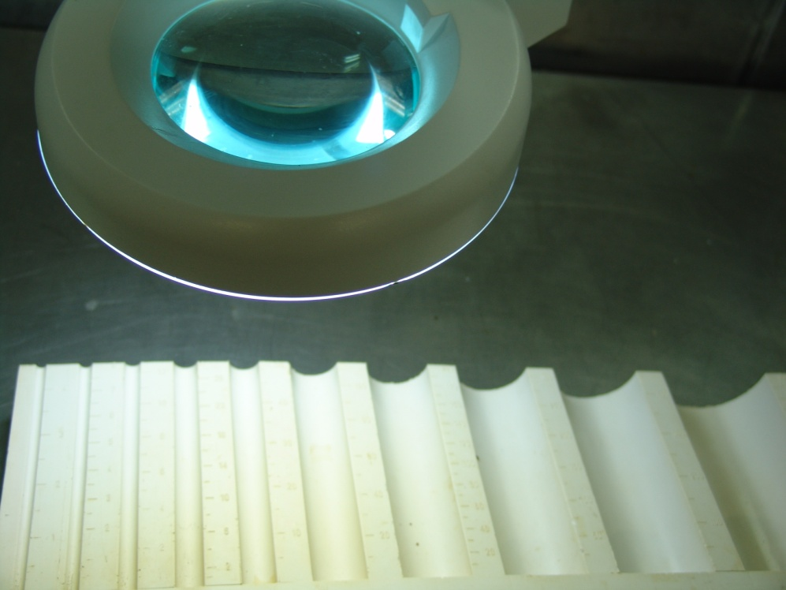

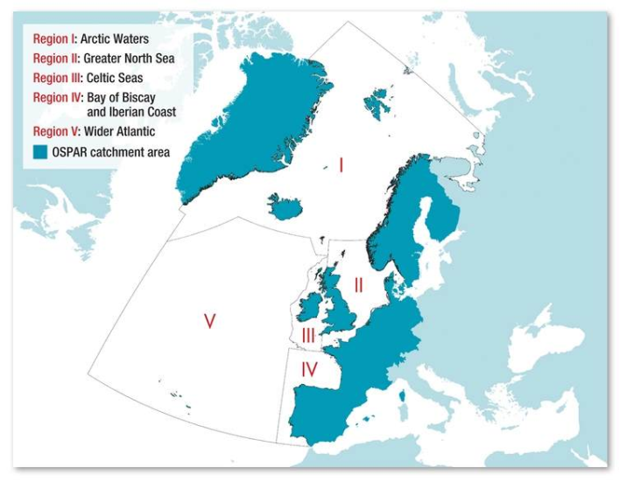
Study area
FW4. OSPAR Regions and sub-regions
Regions
Sub- regions

Slide 3
A little background
1
2
FW4 : Changes in average trophic level of marine predators (MTL)
Arroyo et al. 2019. ICES Journal of Marine Science
Small scale spatial variations of trawling impact on food web structure
Preciado et al. 2019. Ecological indicators
Temporal approach
Spatial approach
Recovery of BoB’s bentho-demersal system (survey data)
- A “fishing through” process (landings) may be masking the expansion of demersal fisheries to deeper waters, and an over-exploitation of resources
Negative relationship between fishing effort and mean Trophic Level (mTL) of benthic and demersal communities
A strong local influence of this anthropogenic pressure on the benthic-demersal food webs
New purpose: spatio-temporal approach

Slide 4

Database I: Datras (biomass)
Availability- online database
Standardised data
Long-term data
Data: mainly fish (commercial cephalopods and crustaceans). Problems to calculate MTL_2.0?
Databases uploaded by each country: differences in species, data (B, sizes), time series, seasons/quarters, gears.
No clear relation between catch and hauls (errors detected)
Biomass data were not always available (only sizes)

Slide 5
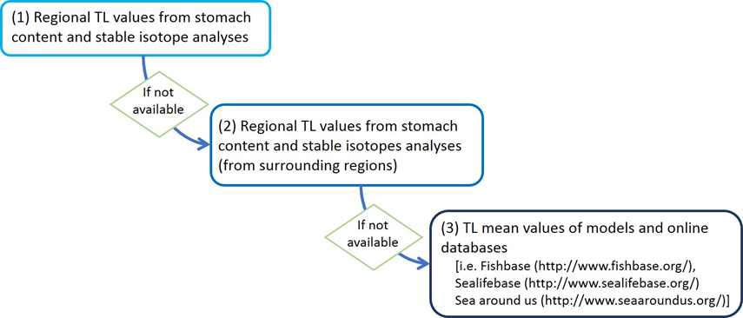
Database II: Trophic levels (TLs)
Summary of the different scenarios in the MTL indicator
MTL_2.0 | TL cut-off of 2.0 (including all consumers into the analysis)
MTL_3.25 | TL cut-off of 3.25 (=MTI of Pauly & Watson 2005)
MTL_4.0 | TL cut-off of 4.0 (focus on higher predators)

Slide 6

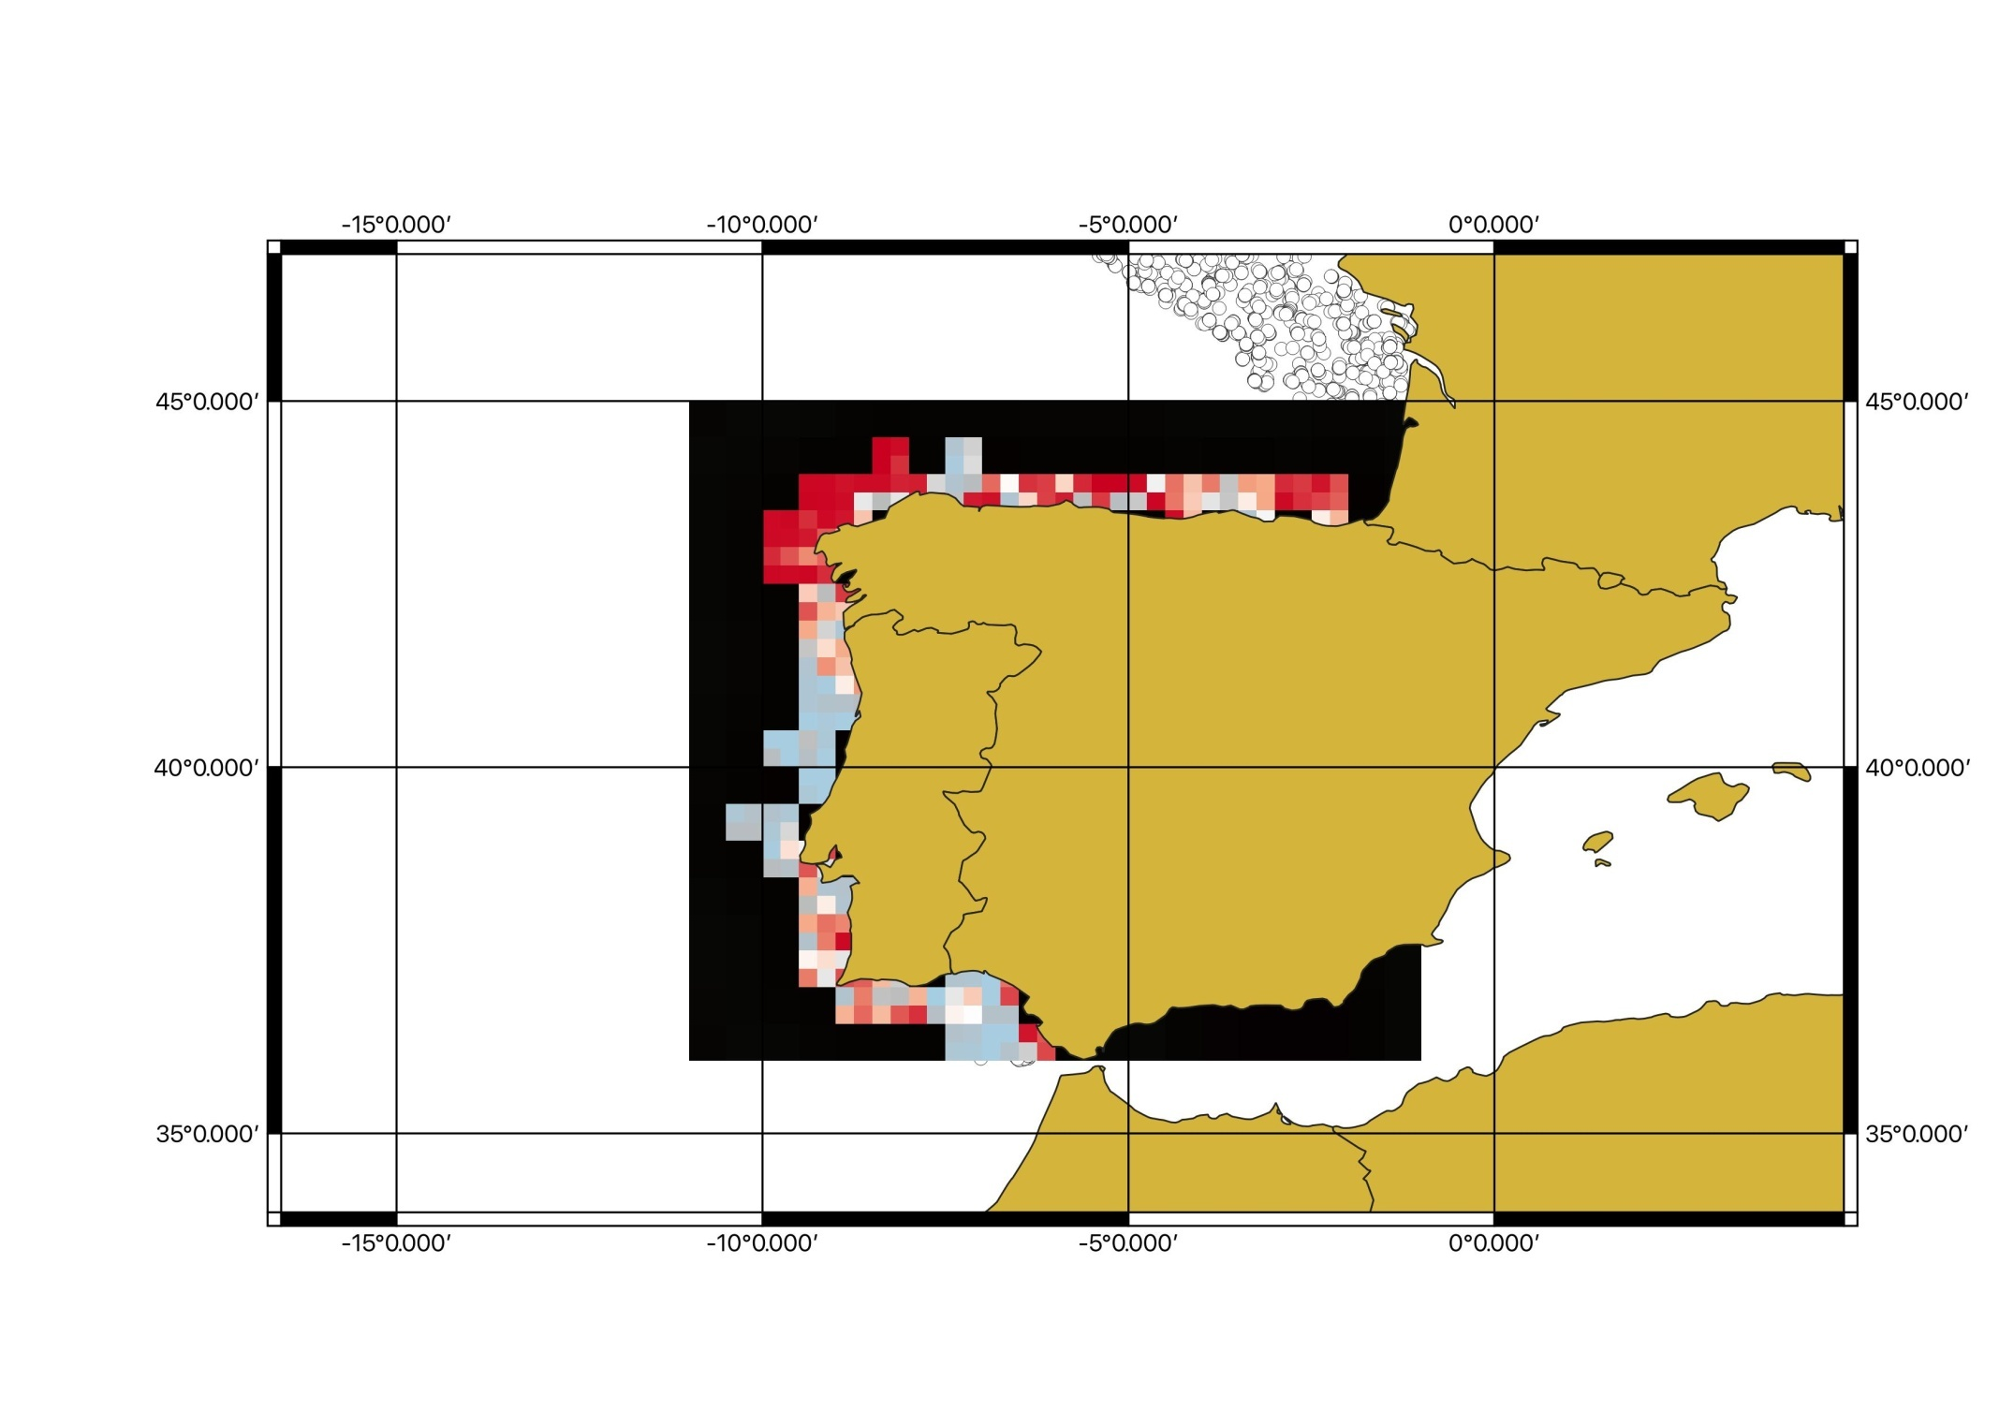
Testing framework
Associate covariates: depth, slope, SST, chl
DATRAS:
Biomass by haul by year
Local TL per species (i)
Biomass per haul per species (Yi) per year (k)
Filter cut-off TL > 2.0
Filter cut-off TL > 3.25
Filter cut-off TL > 4.0
MTL_2.0, MTL_3.25, MTL_4.0, per haul
MTL by haul by year
Interpolation of MTL spatially by year (k nearest neighbors)
INCREASING TREND
Trend of MTL per square. Spatial representation.
NO TREND
DECREASING TREND

Slide 7
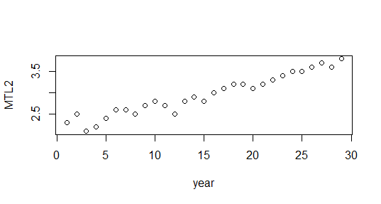
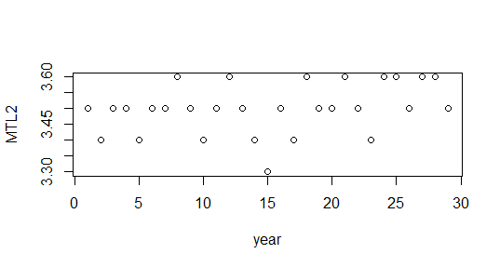
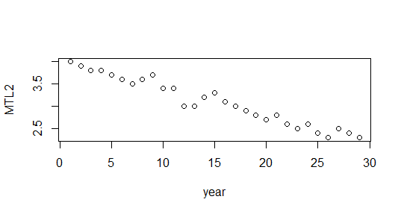
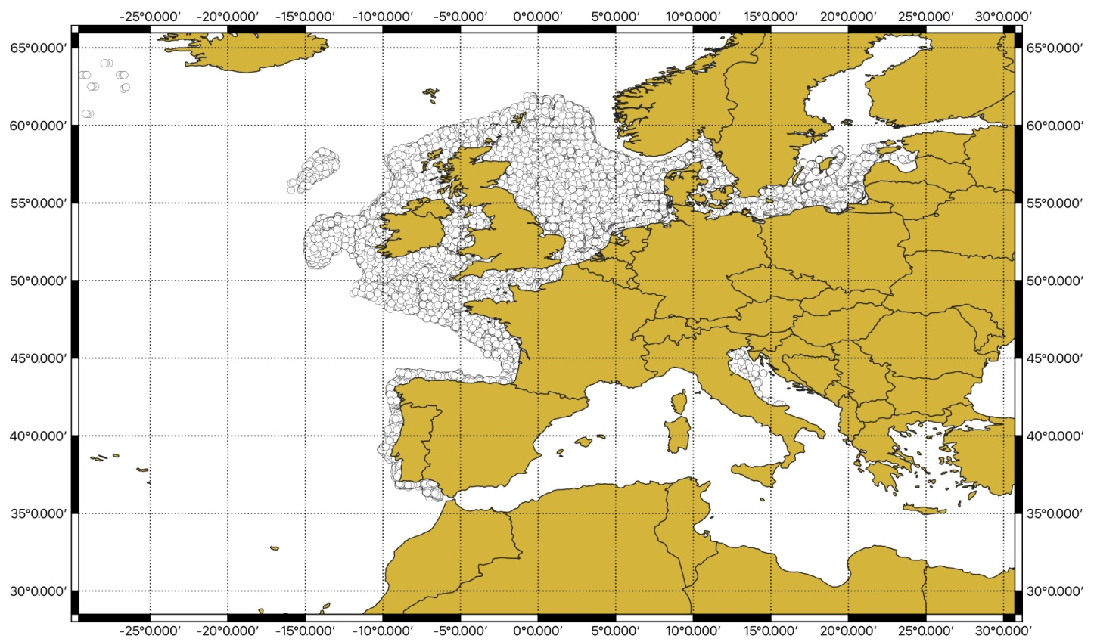
Methodology

Slide 8
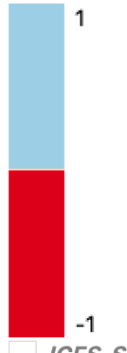
First results: MTL_2.0
* TL cut-off of 2.0 (including all consumers into the analysis)

Slide 9
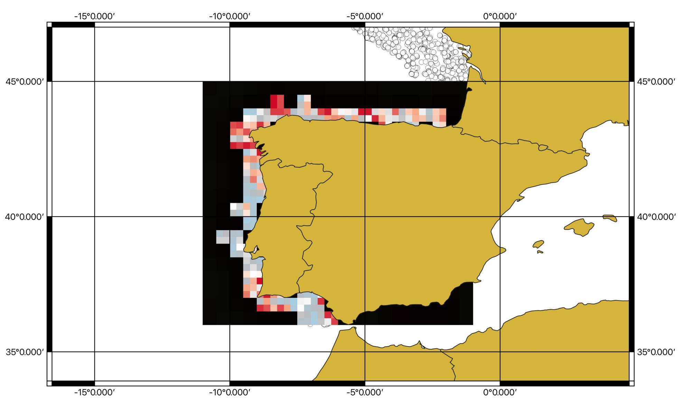
First results: MTL_3.25
*TL cut-off of 3.25 (=MTI of Pauly & Watson 2005)

Slide 10
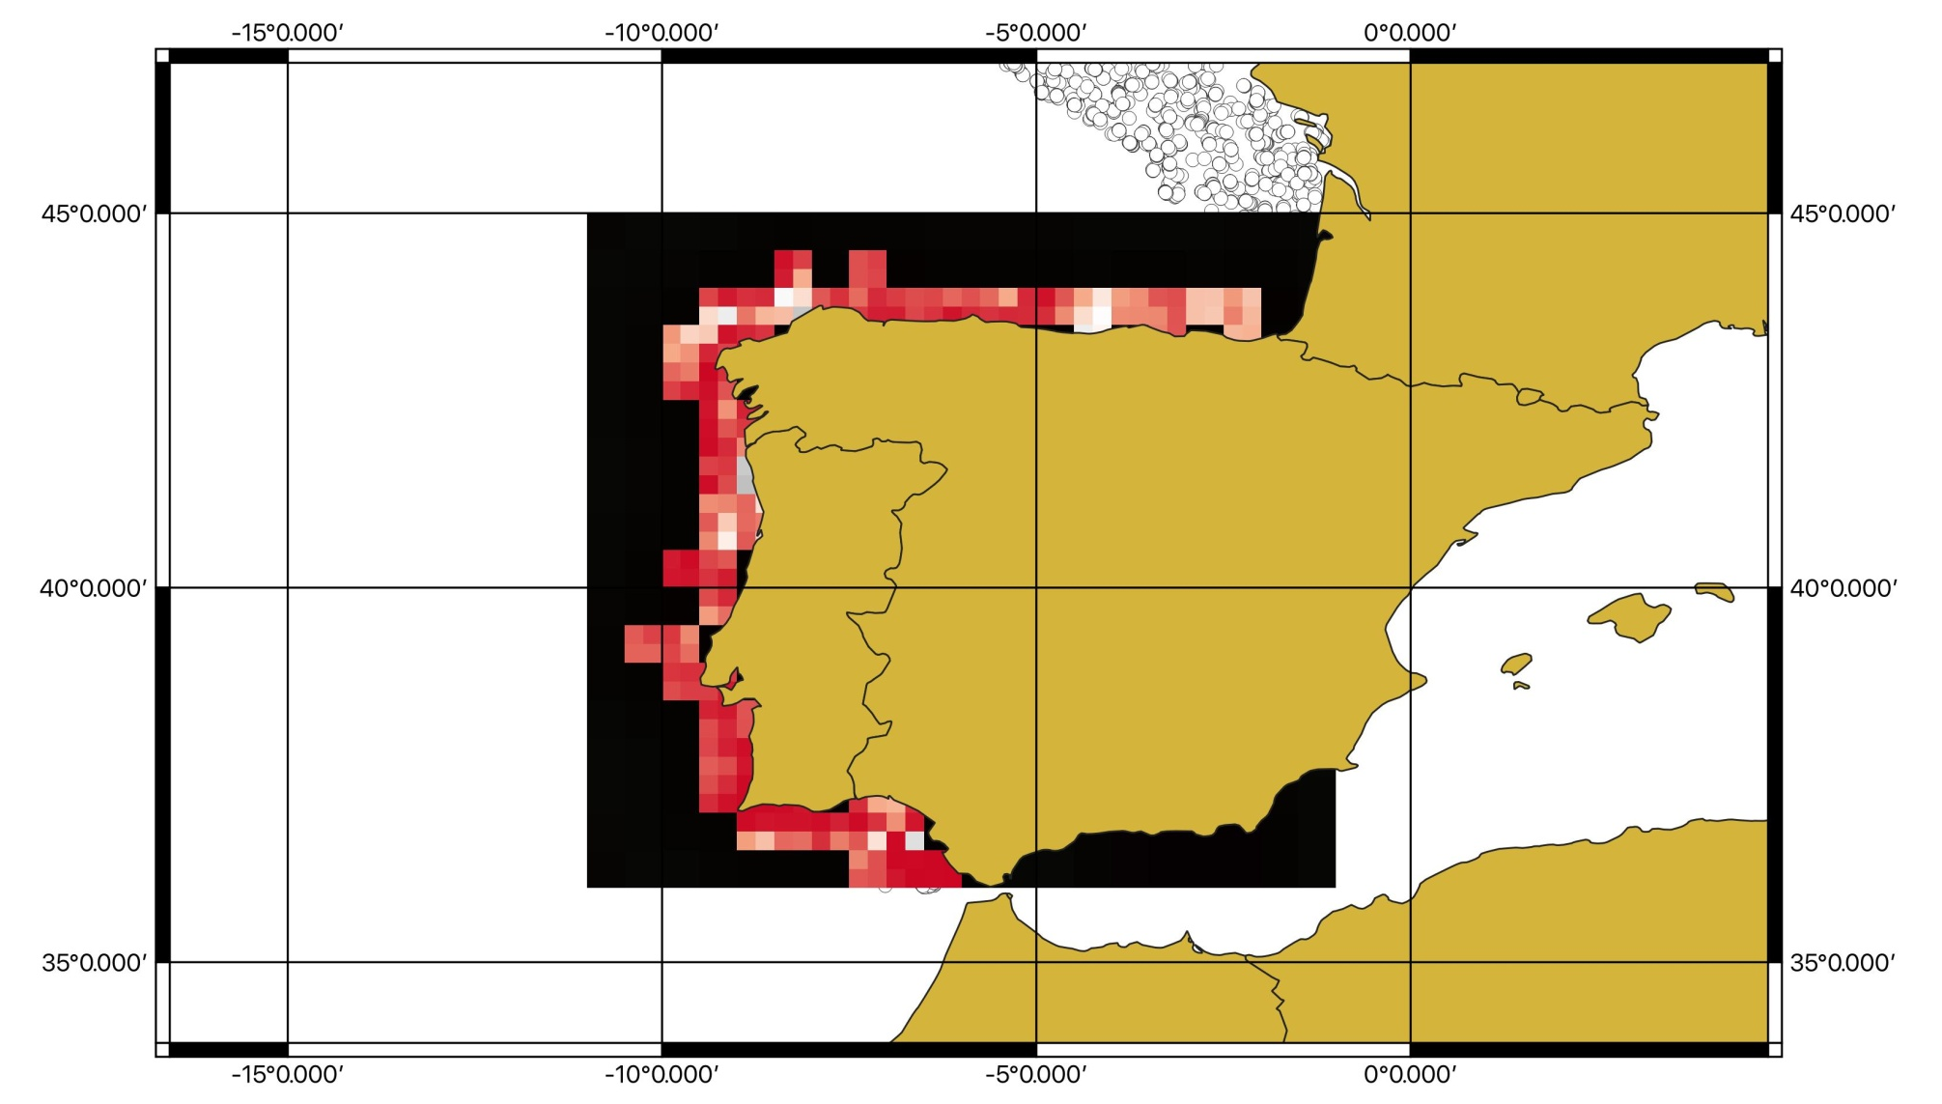
First results: MTL_4.0
*TL cut-off of 4.0 (focus on higher predators)

Slide 11
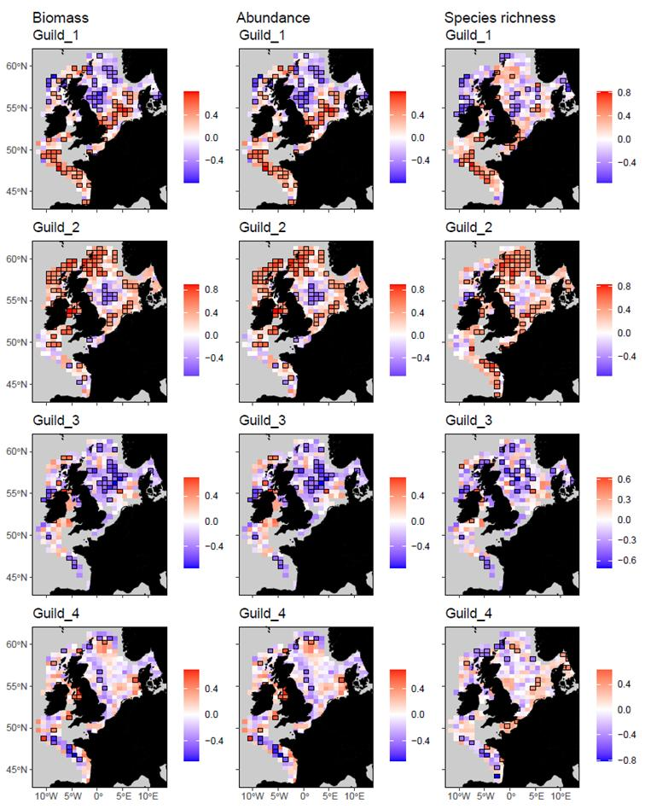
FW7
Different ways of grouping the same thing.
Same rationale!

Slide 12
Further steps
Update and improve regional TLs database (stomach contents and stable isotope analyses)
Include other regions/(sub-) regions in the analyses: French continental shelf (in progress), Region II ??
To test different grid sizes, regressions and interpolations types
Improve GAM analyses and predicted maps.
To incorporate additional covariables in the models (e.g. fishing pressure) to test the impact of anthropogenic stressors on the MTL => thresholds?

Slide 13
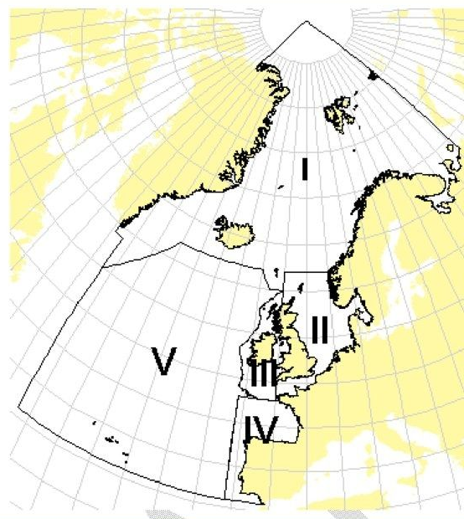
Region II
Ecological (sub)regions?
Quarters/months?
Years?
Countries?
Gears?
Depth?
Species?

Slide 14
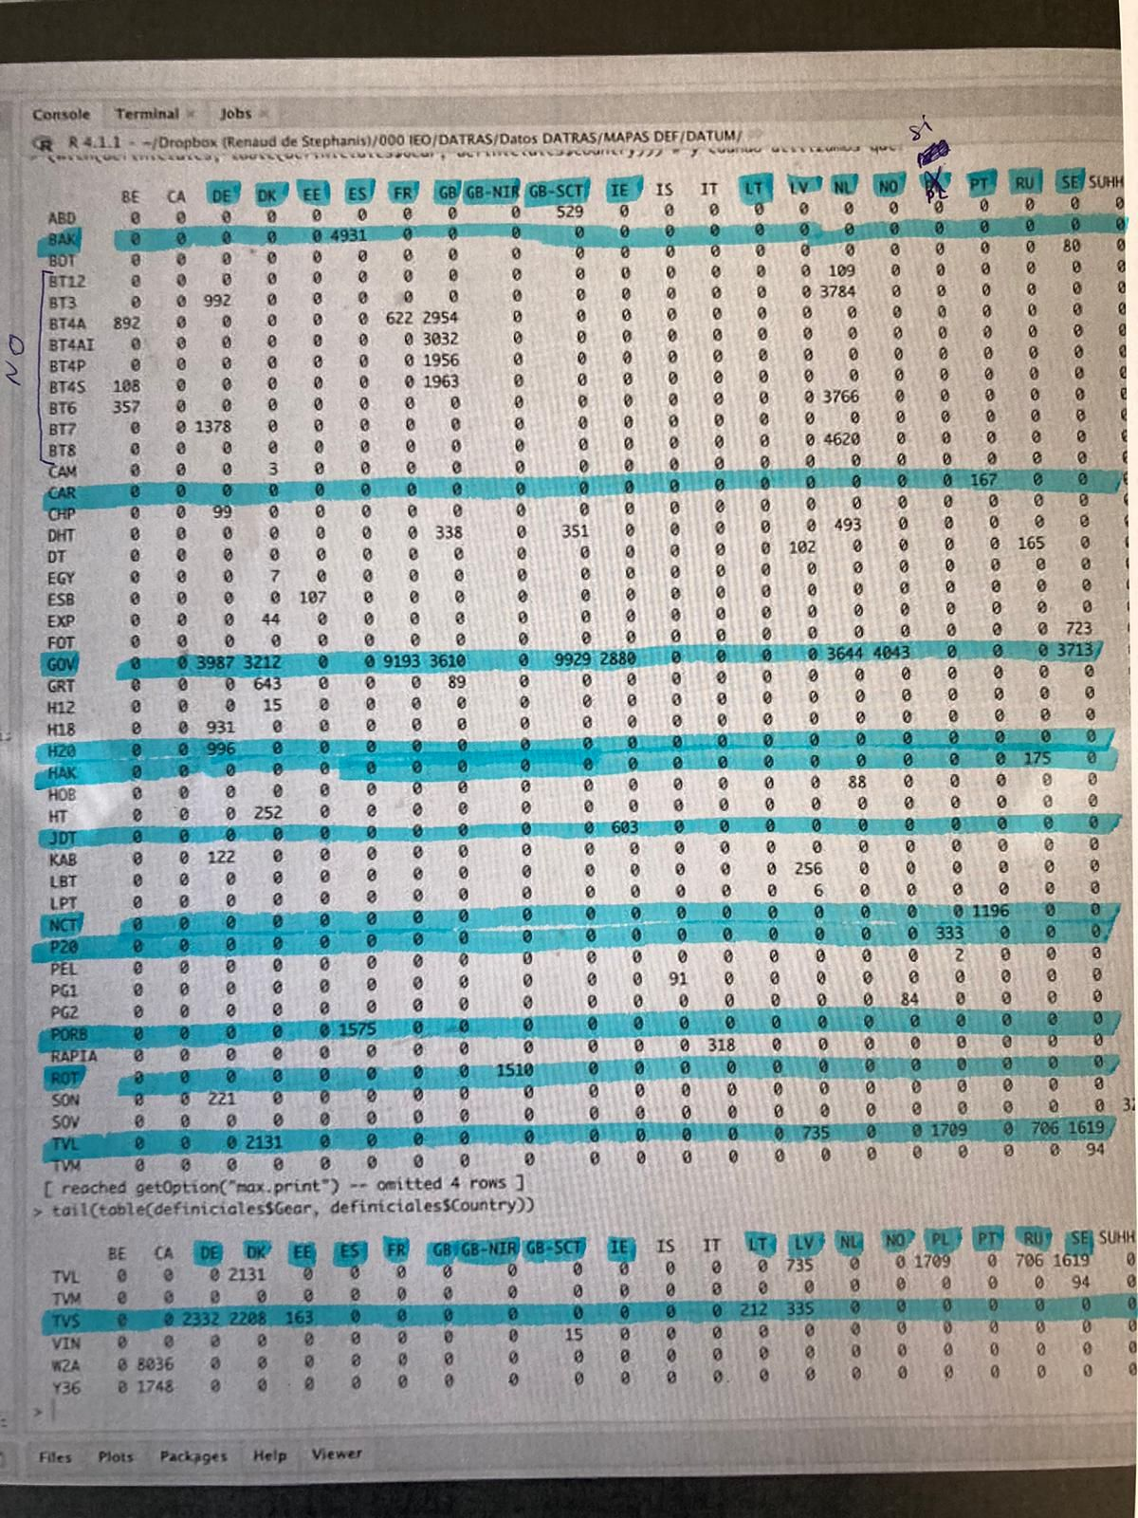
GEARS ??
COUNTRIES ??

